Slide 1
All About BARMAN
Disaster Recovery, the next level
https://www.linuxfestnorthwest.org/conferences/2019/program/proposals/294
https://gitlab.com/rbernier/linuxfest-2019-all-about-barman

Slide 2
All About BARMAN
Before We Start
Hello, my name is Robert
Where to find this presentation
The problem with this presentation (too much information)
  postgres concepts
  barman concepts
  create and managing the environment
  show how to use it, sort of
  show how to create the environment
Underlying assumptions getting through this presentation
  postgres DBA
  linux (CENTOS 7)
REFERENCE:
http://docs.pgbarman.org/release/2.7

Slide 3
All About BARMAN
Disaster Recovery, the next level
Barman is cool

Slide 4
All About BARMAN
ABOUT BARMAN
Barman is an administration tool for disaster recovery of PostgreSQL
can perform remote backups
backup multiple servers
facilitates disaster recovery

Slide 5
All About BARMAN
WHY USE BARMAN
data corruption
system failure (including hardware failure)
human error
natural disaster

Slide 6
All About BARMAN
Proactive Disaster Recovery Practices
Backup policies (logical dumps)
  Daily
  Weekly
  Monthly
Barman
  Backup
    Manual (barman backup all)
    Automated (barman cron)
  Full recovery
  Partial recovery via Point in time recovery (PITR)
    transaction id
    timestamp

Slide 7
All About BARMAN
About Barman Backups
A Barman Backup is comprised of the following:
  base backup
  WAL archiving
    LOG SHIPPING
    streaming
Types of hosts that can be recreated
  standalone
  replication slave/clustered

Slide 8
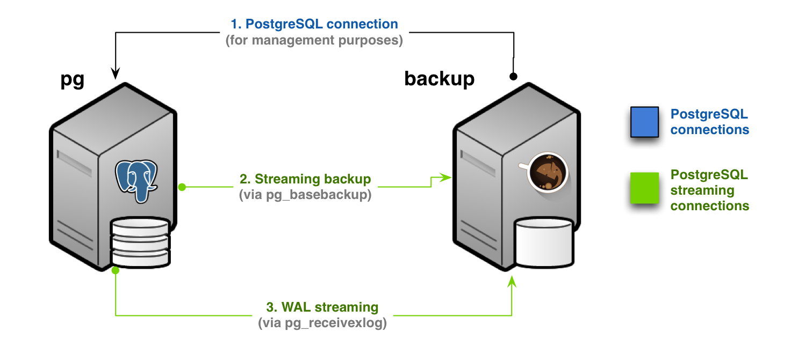
All About BARMAN
ABOUT THE NETWORK ENVIRONMENT

Slide 9
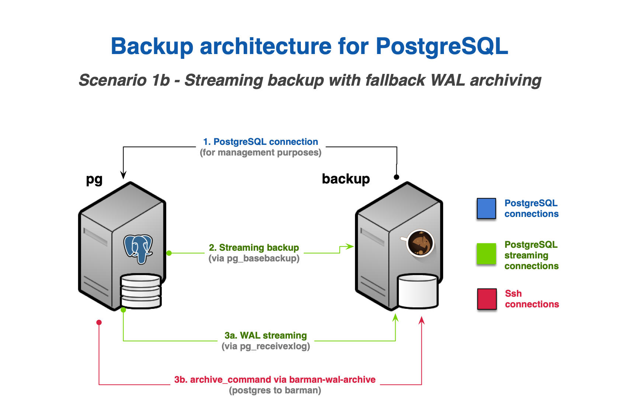
All About BARMAN
ABOUT THE NETWORK ENVIRONMENT

Slide 10
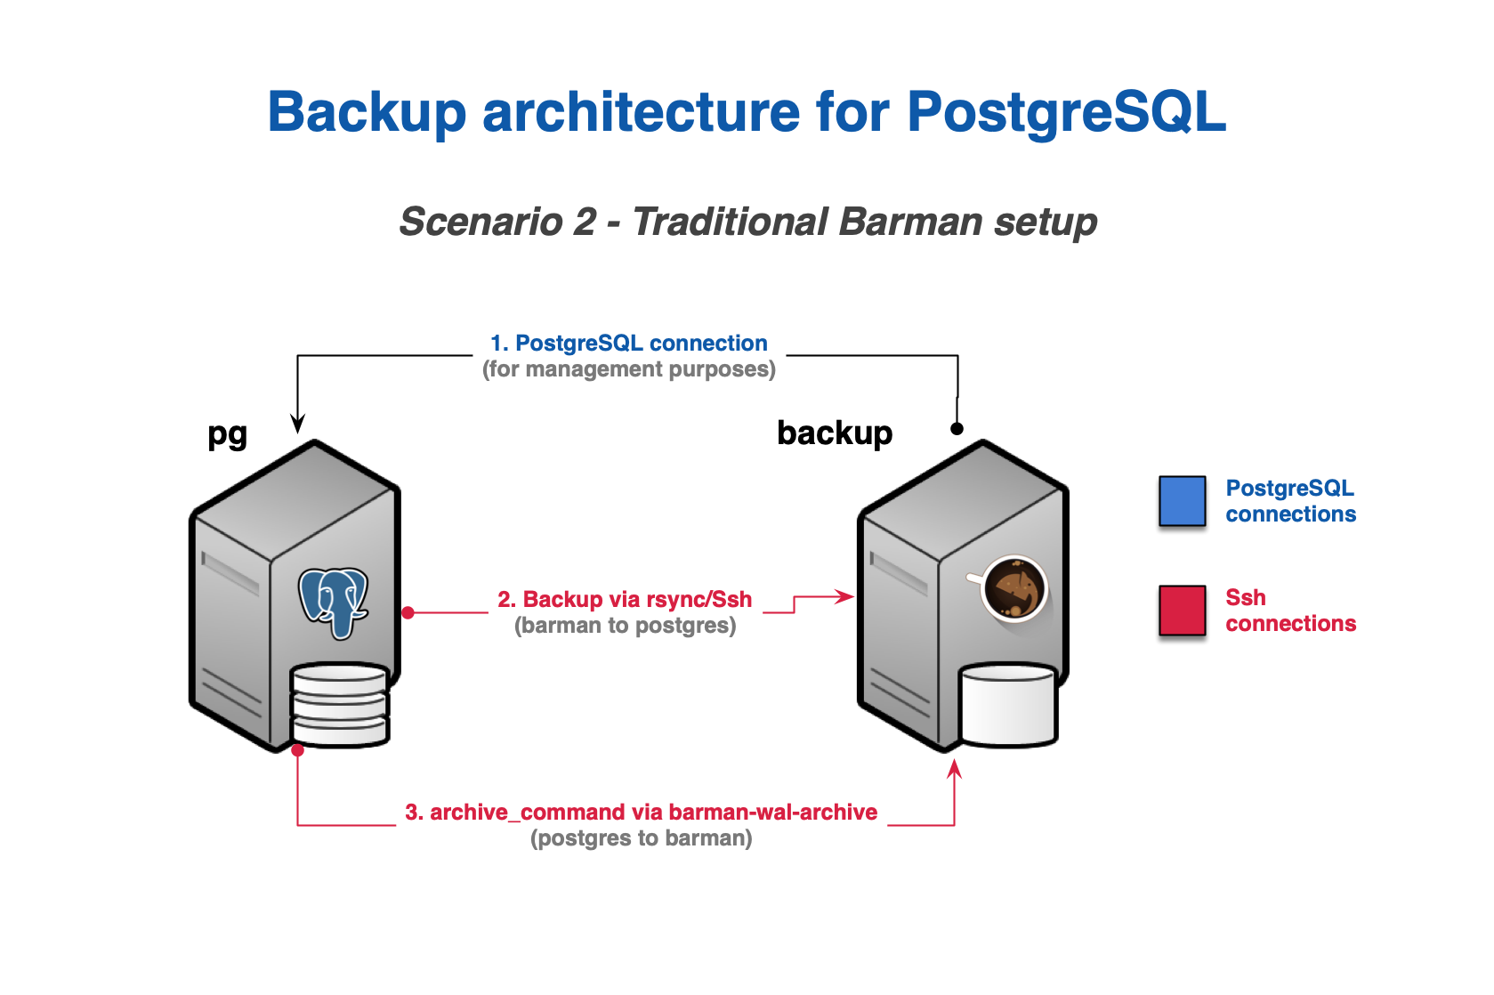
All About BARMAN
ABOUT THE NETWORK ENVIRONMENT

Slide 11
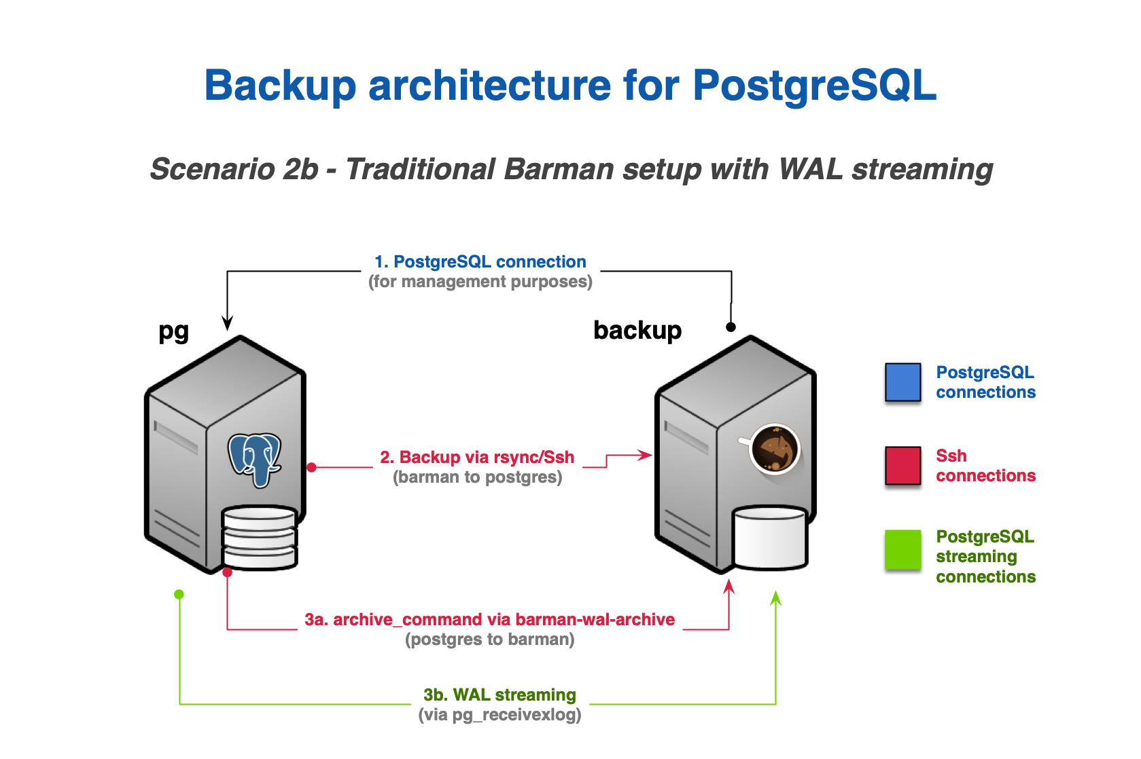
All About BARMAN
ABOUT THE NETWORK ENVIRONMENT

Slide 12
All About BARMAN
About the DEMO Environment
Hosts
  barman_pg1 # master
  barman_pg2 # slave
  barman_pg3 # recovery target
  barman # administration
master/slave ....
  high performance
  high availability
  This is NOT for disaster recovery

Slide 13
All About BARMAN
CREATING MY DEMO ENVIRONMENT
What you're dealing with:
linux containers
PostgreSQL HOSTs; barman_pg1, barman_pg2, barman_pg3
Barman host: barman
configuring community repo for all the hosts
installing packages on all hosts
multiple unix accounts: postgres, barman
  ssh public/private keys between all hosts
    UNIX postgres -> all servers including barman
    UNIX barman -> all pg servers
configuring
  postgres
  barman

Slide 14
All About BARMAN
Barman about mastering the configuration files
├── barman
│ └── etc
│ ├── barman.conf
│ └── barman.d
│ ├── barman_pg1_ssh_server.conf
│ ├── barman_pg2_streaming_server.conf
│ ├── passive-server.conf-template
│ ├── ssh-server.conf-template
│ └── streaming-server.conf-template
└── barman_pg1 (PGDATA)
├── pg_hba.conf
├── postgresql.auto.conf
└── postgresql.conf

Slide 15
All About BARMAN
CONFIGURATION
LOG SHIPPING (barman_pg1)
# postgresql.auto.conf
archive_command = 'rsync -a %p barman@barman:/var/lib/barman/pg1_ssh_server/incoming/%f'
Streaming (barman_pg2)
# execute from host:barman
/usr/bin/barman -c /etc/barman.conf -q receive-wal pg2_streaming

Slide 16
All About BARMAN
Introducing command line interfaces
CLI
  Barman # installed on barman host
  Barman-wal-archive # installed on postgres hosts
  Barman-wal-restore # installed on postgres hosts

Slide 17
All About BARMAN
EXAMPLE CLI INVOCATIONS
# Example invocations are executed on host barman
README_ex_cli_invocations.md

Slide 18
All About BARMAN
Automating Backups
usage: barman cron [-h]
Run maintenance tasks (global command)
optional arguments:
-h, --help show this help message and exit

Slide 19
All About BARMAN
Building the environment
./build_env.sh

Slide 20
All About BARMAN
Disaster Recovery, the next level
QUESTIONS ?

